Slide 1
Turtle
python

Slide 2
Turtle:
Turtle is a special of feature of Python which lets us to draw in drawing board.
First, we have to import the module called turtle.
# import turtle
Then create a graphics window on which we can draw.
#turtle.Screen()
To draw, we need a drawing object.
#turtle.Turtle()

Slide 3
Drawing:
To draw different objects, we need to access the methods available in turtle module.
There are different methods available for drawing.
forward(amount) – to move forward.
Backward(amount) – to move backward.
left(angle) – to turn to the left by making specific angle.
right(angle) – to turn to the right by making specific angle.
up() – taking drawing object up.
down() – taking drawing object down.

Slide 4
Method:
color(colorname) – change the drawing object color.
fillcolor() – change the color of turtle.
position() – returns the current position.
goto() – it moves the turtle to the position to x,y.
begin_fill() – remember starting point for fill polygon.
end_fill() – closes the polygon and fill the current color.
dot() – leaves dot at the current position.
stamp() - leaves a impression of turtle shape at current location.
shape() – should be arrow, classic, turtle or circle.

Slide 5
Some necessary methods:
For board(graphic window) back color
#bgcolor(colorname)
For exit(stop) window
turtle.done()
Window_object.exitonclick()
To change the size of drawing object
width(amount)

Slide 6
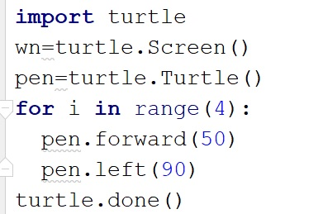
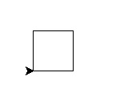
Drawing a square:

Slide 7
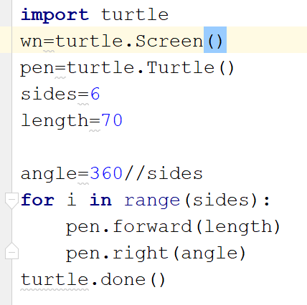
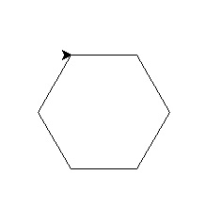
Hexagon:

